Slide 1

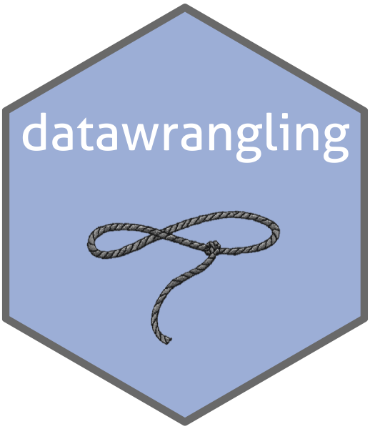

Wrangling People Data
Bernard Voss, MA

Slide 2
Agenda
Data Lifecycle & Key Players
Medallion Architecture
Directed Acyclic Graphs (DAGs)
Best Practices
Demo
Thanks & Wrap Up

Slide 3
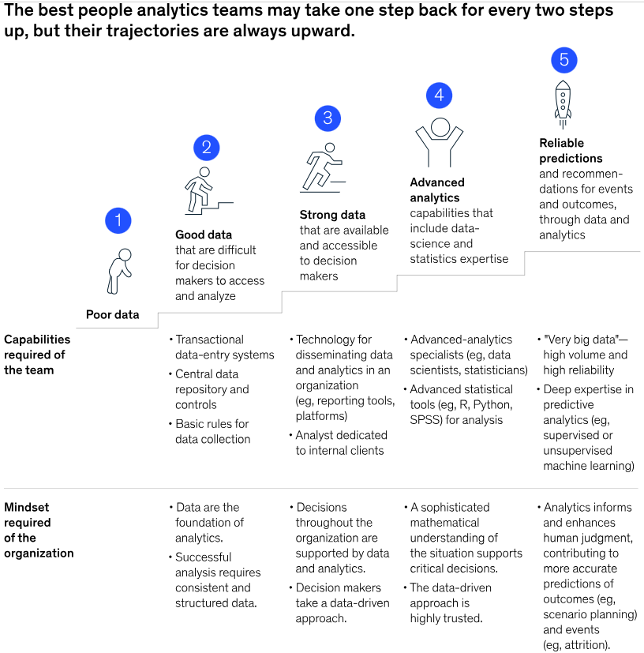

Slide 4
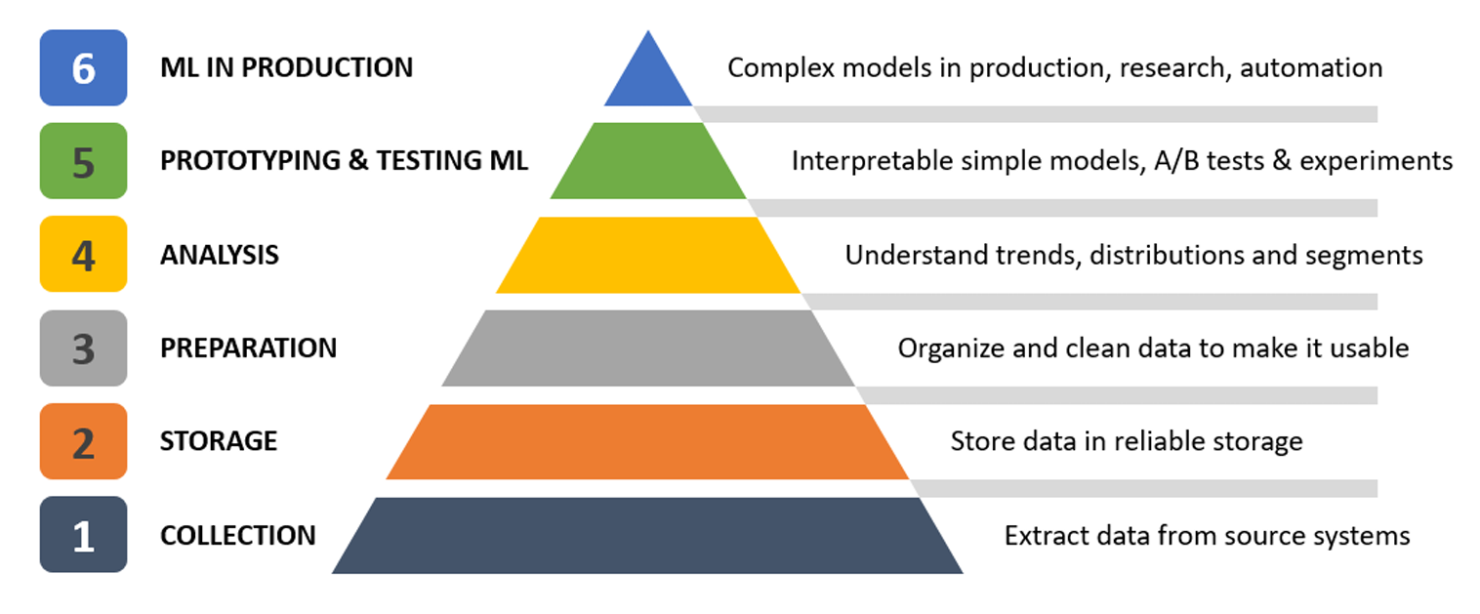
Data to Machine Learning - Tasks
Image taken from Machine Learning for Business. Published on Datacamp by Karolis Urbonas

Slide 5
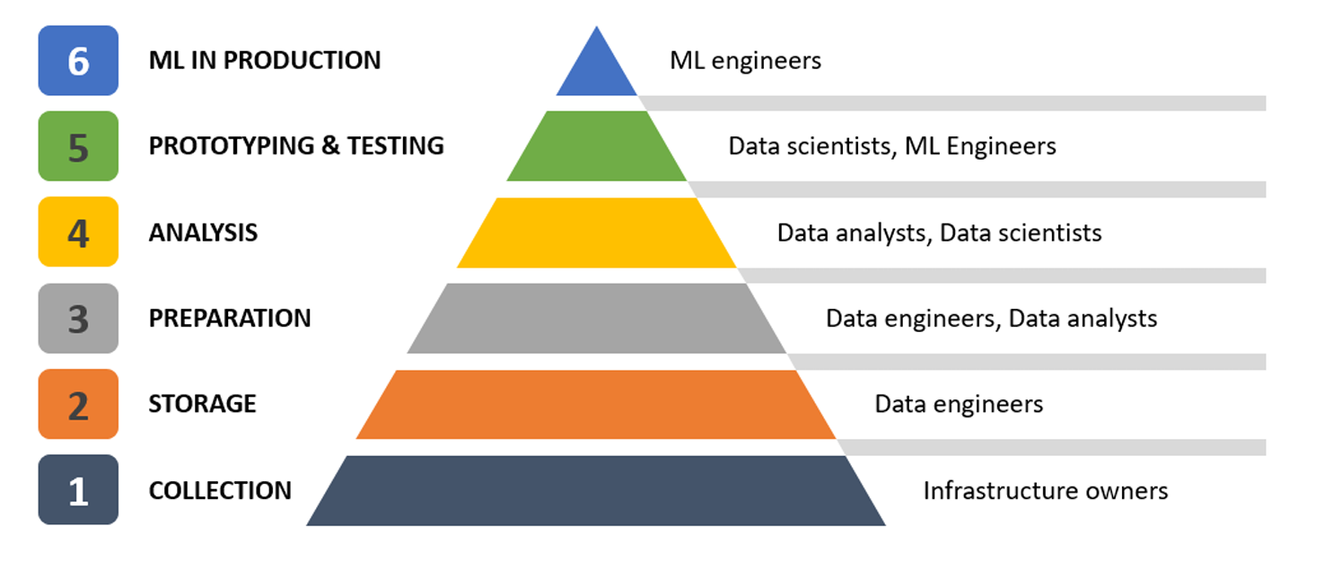
Data to Machine Learning - Roles
Image taken from Machine Learning for Business. Published on Datacamp by Karolis Urbonas

Slide 6


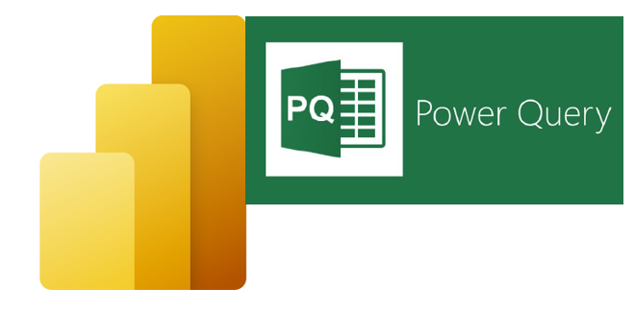

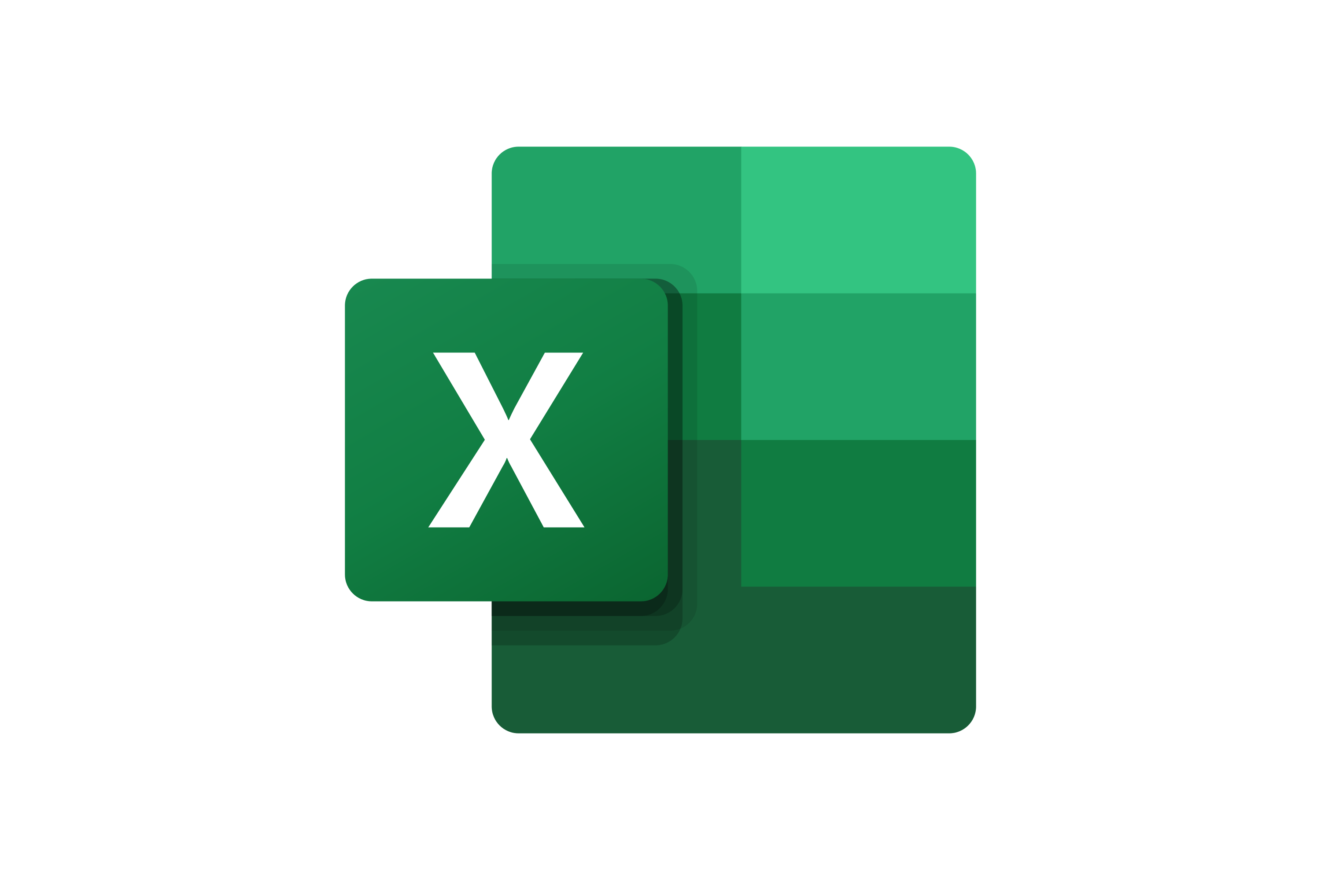
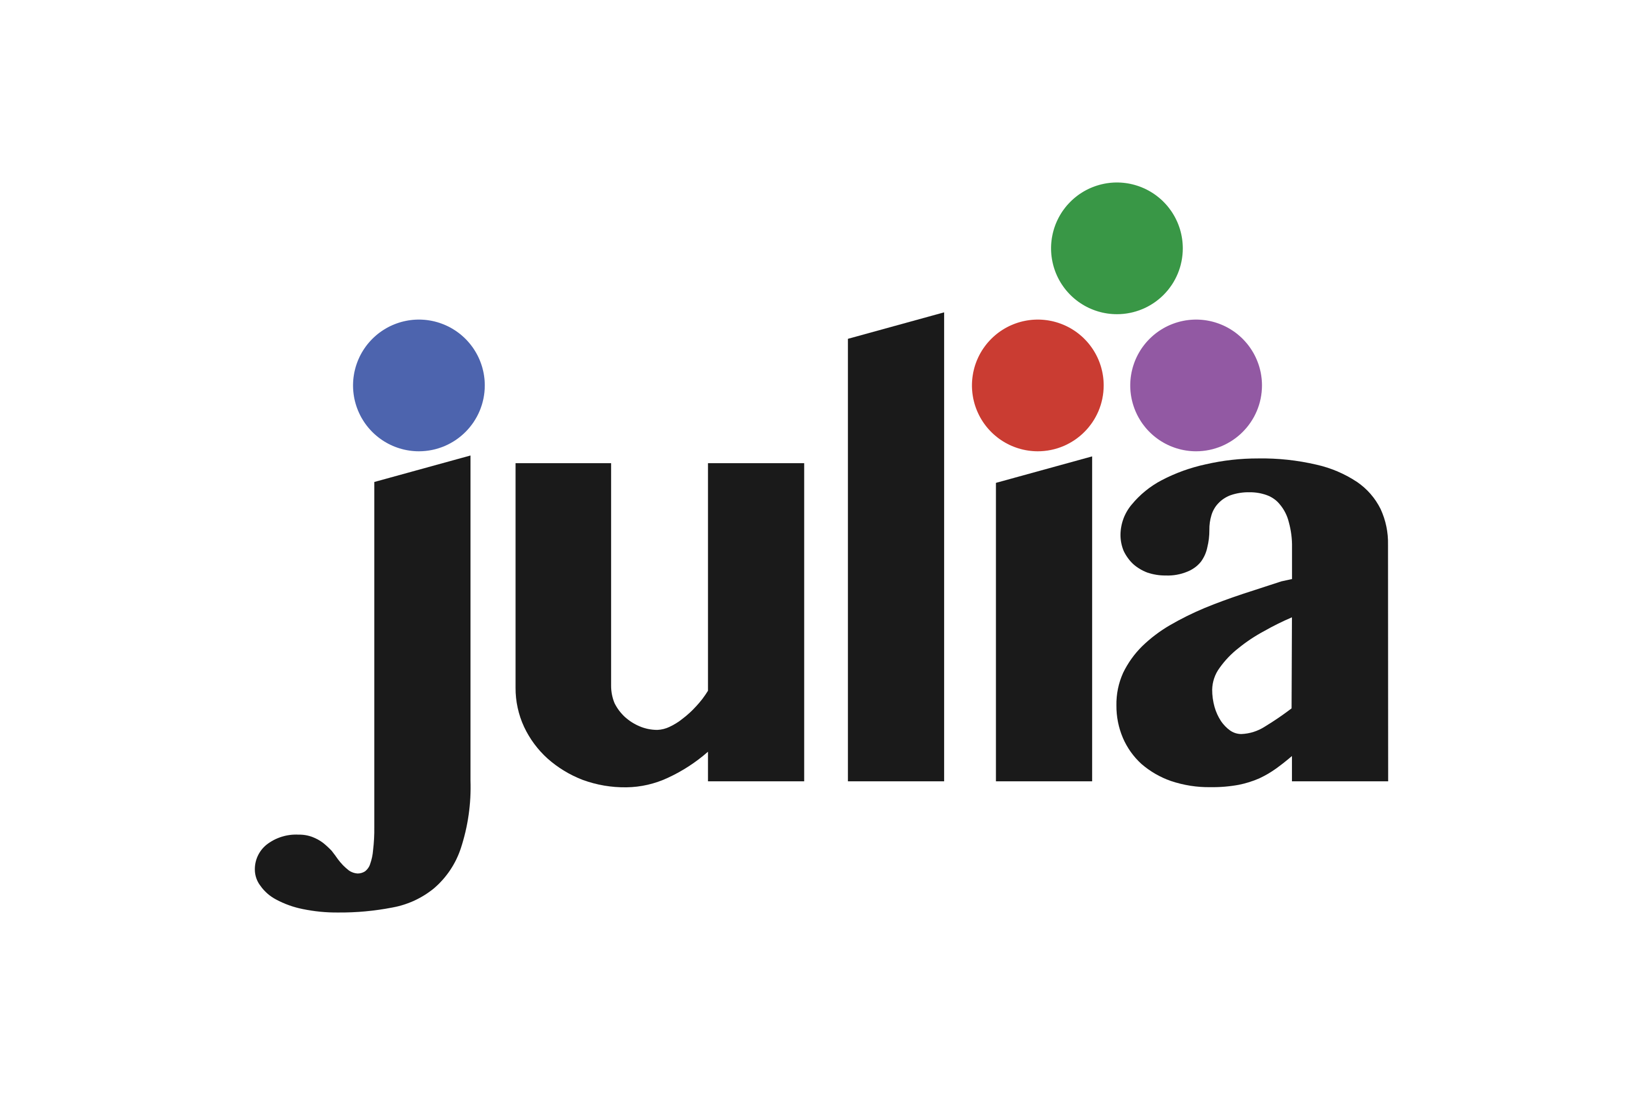

Poll: What’s your tool/language of choice?
Reliable, Repeatable, Reproducible

Slide 7
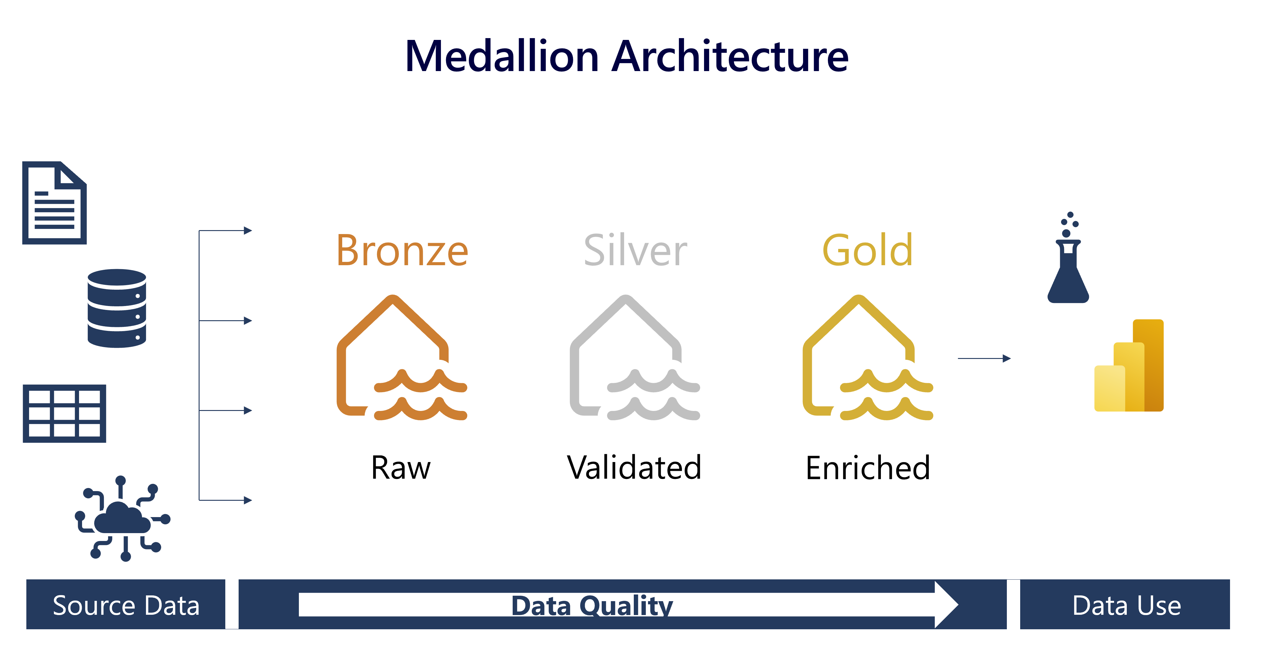
https://www.datasarva.com/lakehouse_medallion_architecture/

Slide 8
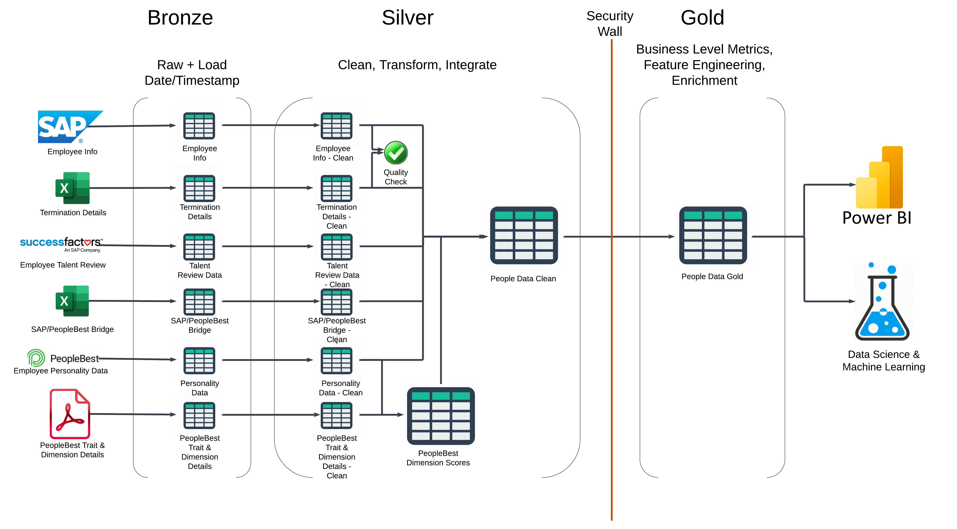
Directed Acyclic Graphs (DAG)

Slide 9
Best Practices
Bias towards over-documentation:
Comments
Unabbreviated table names, column names
Standardized names
E.g., “_clean” in the silver layer
Code Review
Create a Detailed Specification
Build for Future Needs

Slide 10

Thank You
Special thanks to:
NTT Data for the opportunity to conduct this important work.
N Solutions for lunch and collaboration on this project
Todd at Talent Sherpa for serving as an SME and liaison to PeopleBest data.
Angie Schrumpf for planning and coordinating this event!
Raymond Pruett, Mike Grossenbacher, Matt Brown, Neil Berg, & Andy Hicks for code review, feedback, and tips on presenting data work.
PeopleBest Assessments

Slide 11
If you’re interested in projects like this…
Reach out Jenn or Calvin at N Solutions

Slide 12
Next Topic Ideas?
APIs
Data Synthesis (synthpop)
Data Modeling
Star vs. Snowflake Schemas
Normalized tables vs. Denormalized tables
Slowly Changing Dimensions (SCD)
Row Level Security (RLS) in Power BI
Nested Data & Automated Regression
rMarkdown
PeopleBest Part II: Advanced Data Analysis

